Slide 1

Deep Learning-based Semantic Segmentation in Remote Sensing
Machine Learning for Earth System and Sciences
MANSI UNIYAL
19EE10039
SEMINAR

Slide 2
INDEX
DEEP LEARNING
SEMANTIC SEGMENTATION
REMOTE SENSING
OVERVIEW OF PREVIOUS WORK
WORKING OF DEEP LEARNING MODELS
INFERENCES AND PERFORMANCES
SUMMARY
FUTURE SCOPE
REFERENCES

Slide 3
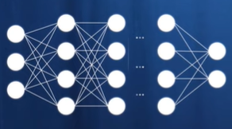
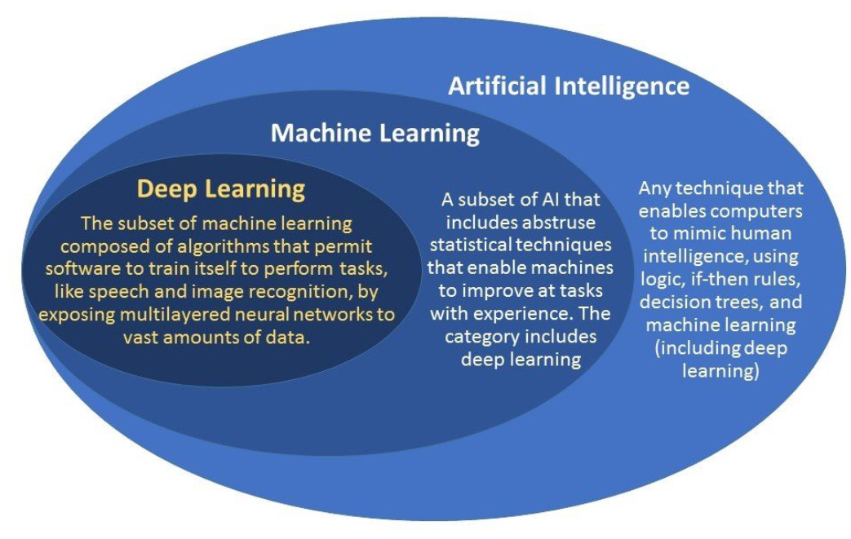
DEEP LEARNING

Slide 4
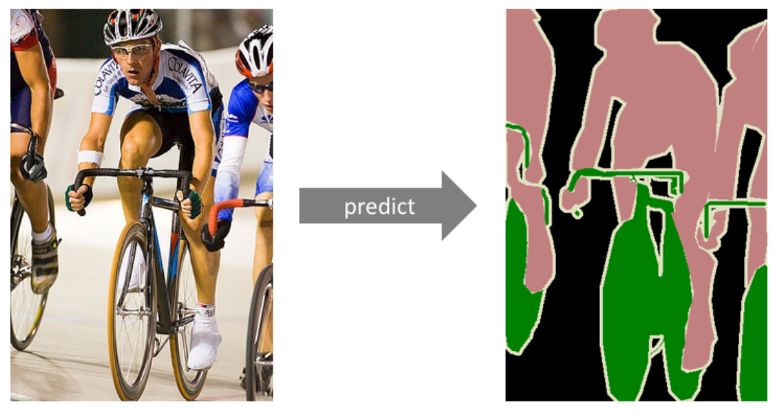
SEMANTIC SEGMENTATION

Slide 5
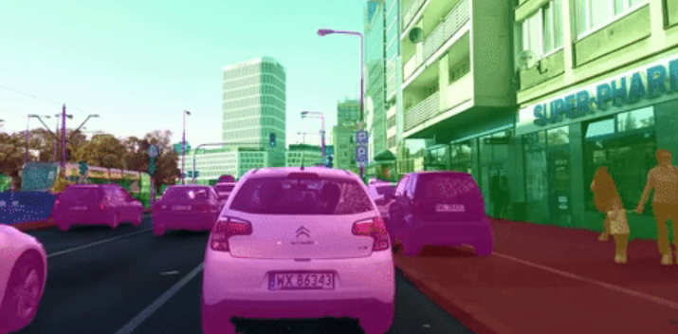
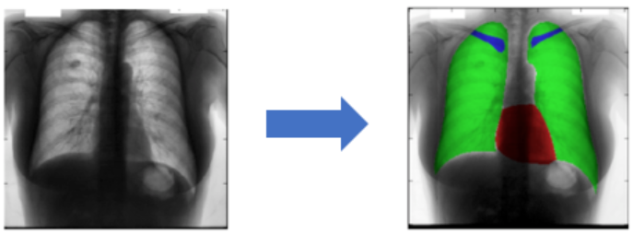
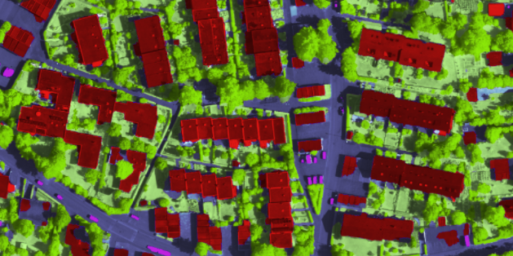
WHY?
Autonomous vehicles
Medical image diagnostics
GeoSpatial Remote Sensing

Slide 6
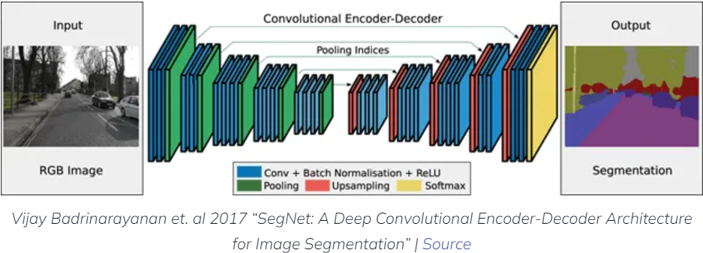
DEEP LEARNING FOR IMAGE SEGMENTATION

Slide 7
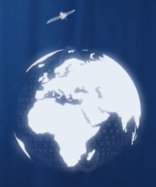
REMOTE SENSING
Process of detecting and monitoring the physical characteristics of an area by measuring its reflected and emitted radiation at a distance. Special cameras collect remotely sensed images, which help researchers "sense" things about the Earth.
EXAMPLES:-
Cameras on satellites and airplanes take images of large areas on the Earth's surface.
Sonar systems on ships can be used to create images of the ocean floor.
Cameras on satellites can be used to make images of temperature changes in the oceans.

Slide 8
WHY?
Large forest fires can be mapped from space, allowing rangers to see a much larger area than from the ground.
Tracking clouds to help predict the weather or watching erupting volcanoes, and help watching for dust storms.
Tracking the growth of a city and changes in farmland or forests over several years or decades.
Discovery and mapping of the rugged topography of the ocean floor (e.g., huge mountain ranges, deep canyons, and the “magnetic striping” on the ocean floor).

Slide 9
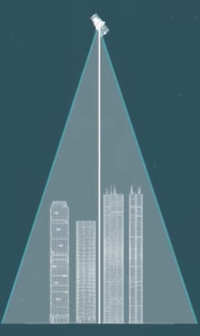
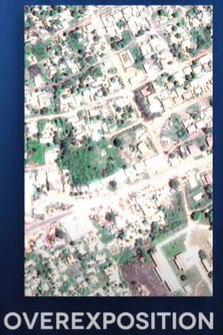
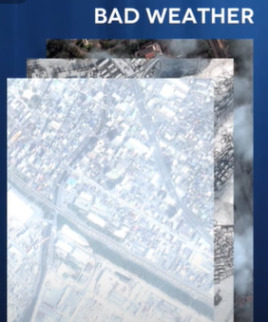
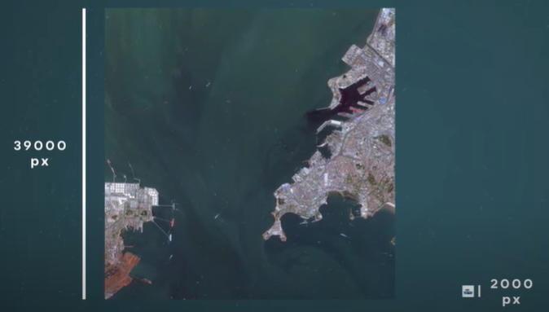
CHALLENGES OF SATELLITE IMAGERY
Size of the images
More number of channels
Geo-referenced images
Metadata information
Decreased resolution
Disturbances and noises
Position of sensor

Slide 10
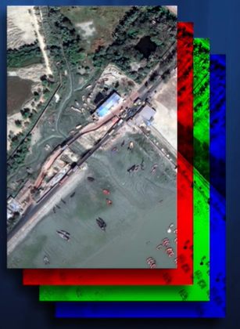
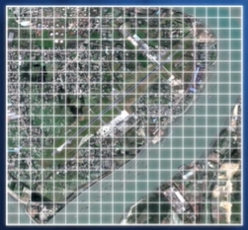
WHY DEEP LEARNING?
Why not COMPUTER VISION?
Few Features
Less Context
Processing the data
Input size of the images
Geo-reference information

Slide 11
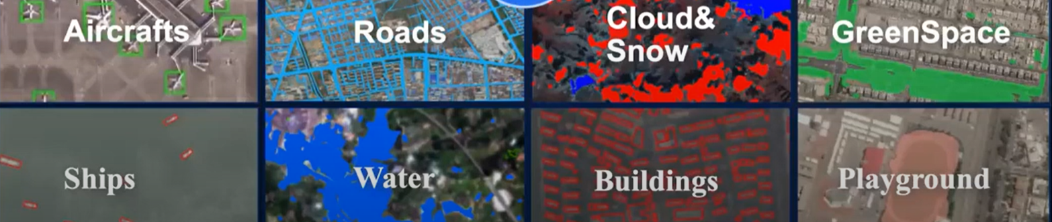
OVERVIEW OF PREVIOUS WORKS
Land Cover Mapping
Extracting and Understanding the Urban Areas
Building extraction
Road extraction
Deforestation Detection

Slide 12
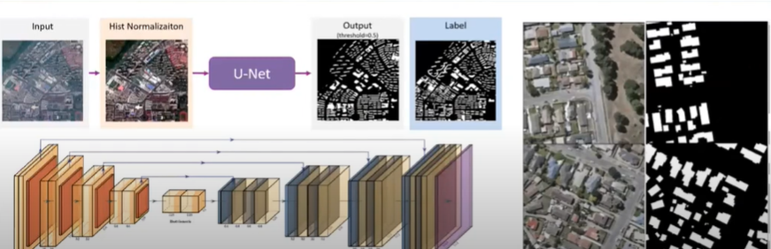
BUILDING EXTRACTION

Slide 13
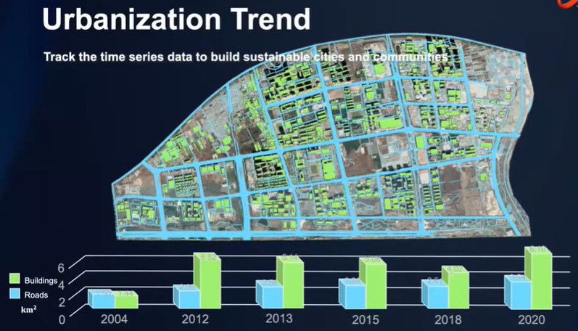

Slide 14
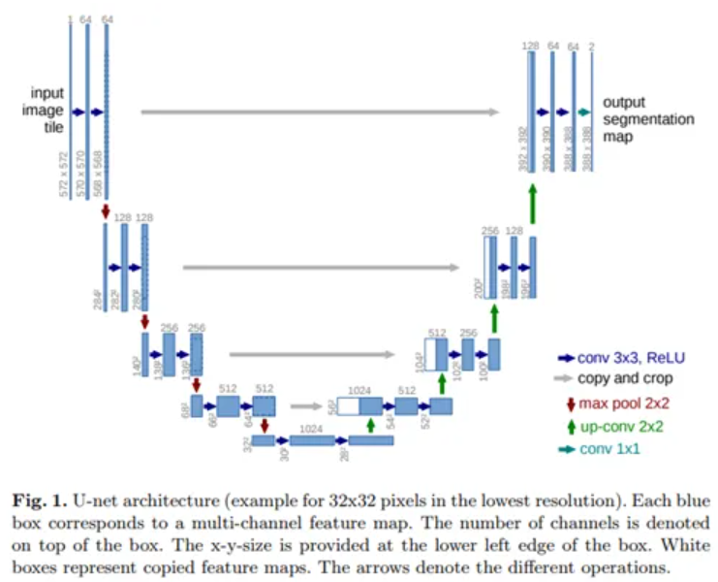
WORKING OF DEEP LEARNING MODELS

Slide 15
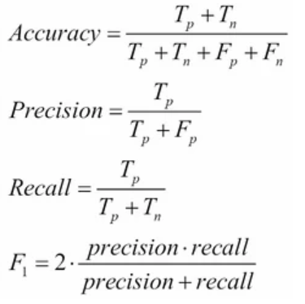
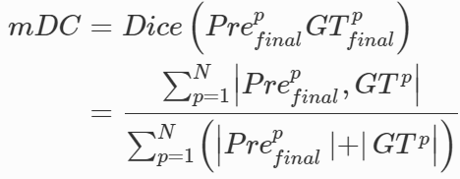
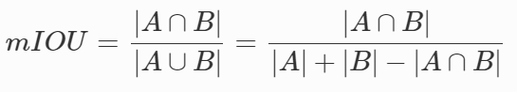
METRICS FOR EVALUATION

Slide 16
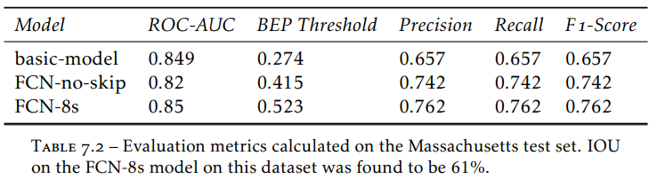
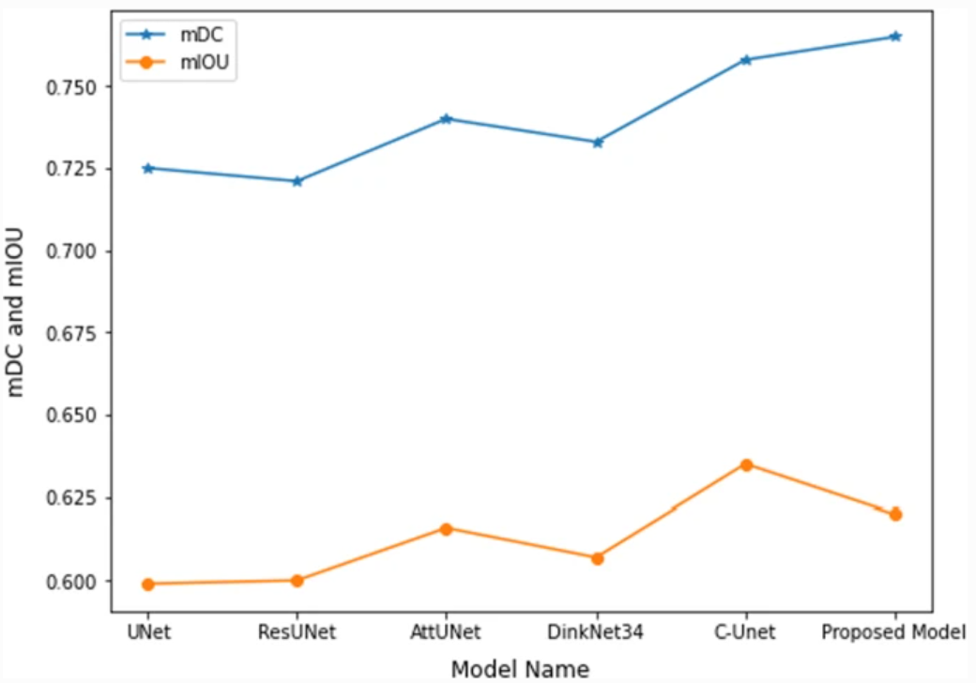
INFERENCES AND PERFORMANCES

Slide 17
SUMMARY
Brief overview of what deep learning, semantic segmentation,
and remote sensing
Application of deep learning in the remote sensing satellite imagery for semantic segmentation of road extraction for urban planning
Challenges in working with satellite images
State-of-the-art implementations
Evaluation techniques

Slide 18
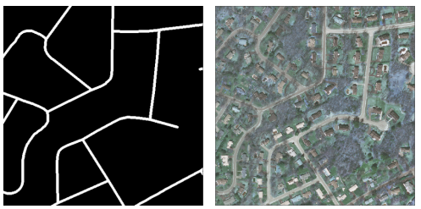
FUTURE SCOPE
Larger training dataset
Improved annotation techniques for better labels
Augmentation schemes to be incorporated
Algorithmic hypertunning
Incorporating attention mechanism

Slide 19
REFERENCES
https://medium.com/@harish_6956/what-is-machine-learning-deep-learning-7788604004da
https://neptune.ai/blog/image-segmentation
https://www.jeremyjordan.me/semantic-segmentation/
https://www.usgs.gov/faqs/what-remote-sensing-and-what-it-used
https://www.youtube.com/watch?v=oO55mK7mgrM
https://www.youtube.com/watch?v=CQlLa_UWncg
https://github.com/chrieke/awesome-satellite-imagery-datasets
https://github.com/bnsreenu/python_for_microscopists
https://www.kaggle.com/datasets/humansintheloop/semantic-segmentation-of-aerial-imagery
https://www.youtube.com/watch?v=jvZm8REF2KY
https://www.youtube.com/watch?v=0W6MKZqSke8
https://www.researchgate.net/figure/Segmentation-results-on-the-Massachusetts-Buildings-Dataset-From-left-to-right-in_fig3_324218706/download
https://www.ijitee.org/wp-content/uploads/papers/v10i8/H91860610821.pdf
https://www.youtube.com/watch?v=-XeKG_T6tdc
https://link.springer.com/article/10.1007/s11227-022-04379-6?utm_source=xmol&utm_medium=affiliate&utm_content=meta&utm_campaign=DDCN_1_GL01_metadata
https://www.diva-portal.org/smash/get/diva2:1013270/FULLTEXT01.pdf

Slide 20
THANK YOU
Machine Learning for Earth System and Sciences
MANSI UNIYAL
19EE10039
SEMINAR

